Slide 1


Automatic Risk Assessment of School Violence
By:
NAME | ID
Mohammed Mostafa Refaat Abd Elhamed | 20191700576
Abdelrahman Hassan Mohamed Mahmoud | 20191700360
Abdelrahman Rezk Ibrahim Eldosoki | 20191700337
Raouf Fayek Attia Abdullah | 2016170571
Sherif Ahmed El-Sayed Ahmed | 2016170219
Supervised by:
Dr. Naglaa Fathy
1

Slide 2
Table of contents
01
Introduction
02
03
04
06
Algorithms and Techniques
Objectives
07
Dataset and results
Related work
08
Demo
Architecture
09
Conclusion
05
Functionalities
2

Slide 3

01
INTRODUCTION
3

Slide 4
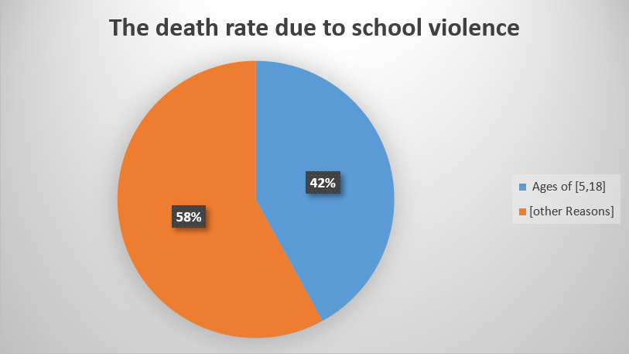
Introduction
In Washington, there were a total of 93 violent deaths related to schools between June 2021 and June 2022. Students, teachers, and non-students were among those who perished in these school-related accidents.
Therefore, by implementing a robust system to identify at-risk children and provide appropriate interventions, we can mitigate the long-term consequences of childhood violence and promote healthier outcomes for both individuals and society as a whole.
4

Slide 5

02
OBJECTIVES
5

Slide 6



Objectives
Developing a system to automate the process of risk assessment for school violence using Machine Learning techniques.
The developed system aims to:
Reduce school violence.
Maintain safety from school violence.
Help parents figure out whether their children are at risk of being violent to their colleagues.
6

Slide 7

03
RELATED WORK
7

Slide 8
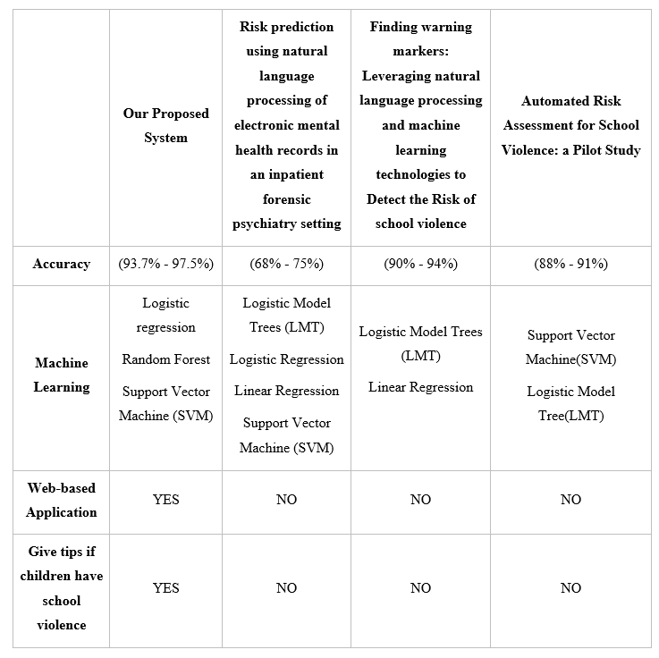
Related work
8

Slide 9

04
9

Slide 10
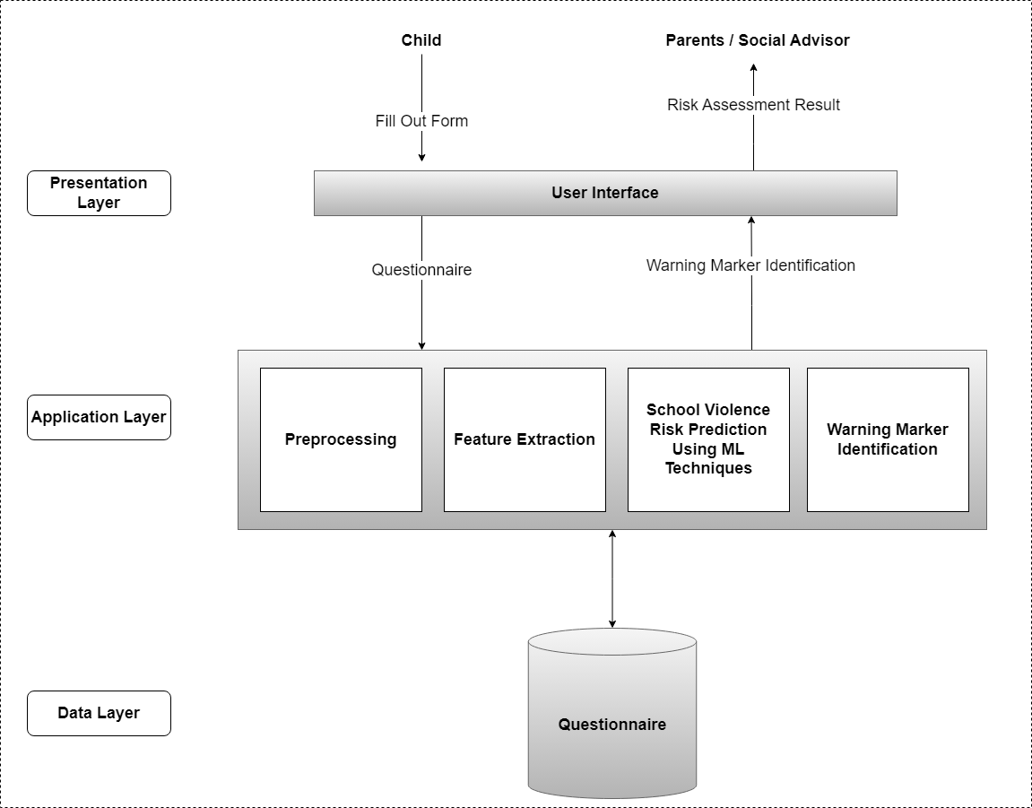
Architecture
10

Slide 11

05
FUNCTIONALITIES
11

Slide 12

Functionalities
1) Child Functionality:
The child must be able to register on the website.
The child must be able to log in and log out of the website.
The child must be able to fill out the questionnaire.
12

Slide 13
Functionalities(cont.)
2) The parent or Social Advisor Functionality:
The parent or social advisor must be able to register on the website.
The parent or social advisor must be able to log in and log out of the website.
The parent or social advisor must be able to receive notifications about the risk level of violence for their children.
The parent or social advisor must be able to view the dashboard of risk assessment of school violence
The parent or social advisor must be able to display tips to avoid the high risk of violence
13

Slide 14
Functionalities(cont..)
3) The AI Model Functionality:
The system shall allow the AI system to detect the risk level of violence.
14

Slide 15

06
ALGORITHMS AND TECHNIQUES
15

Slide 16
Algorithms and Techniques
We employed three algorithms, namely logistic regression, random forest, and support vector machine, to forecast the risk level of violence.
1. Logistic Regression: Logistic regression is a statistical model used for binary classification tasks. analyzes the relationship between the input variables and the probability of an individual being at a certain risk level of violence.
2. Random Forest: In the case of predicting violence risk, random forest creates a collection of decision trees, each trained on a different subset of the data with random feature selection. It then aggregates the predictions of all the trees to determine the risk level of violence for an individual.
3. Support Vector Machine (SVM): SVM can be used for both classification and regression tasks. In the context of violence risk prediction, SVM analyzes the input features to create a decision boundary that maximally separates different risk levels of violence.
16

Slide 17

07
DATASET AND RESULTS
17

Slide 18
Dataset
Data Preparation
To assess the risks of violence in adolescents, a comprehensive questionnaire was designed, incorporating the identified risk factors from the study titled "Assessing the Risks of Violence in Adolescents in the Pediatric Emergency Department".
To ensure the validity and relevance of the included risk factors, an interview was conducted with Dr. Tariq Muhammad Al-Sahrawi, Professor of Psychiatry, Ain Shams College of Medicine, Deputy Director of Prof. Dr. Ahmed Okasha Center for Psychiatry. During the interview, specific attention was given to assigning appropriate weights to each question in the questionnaire.
18

Slide 19
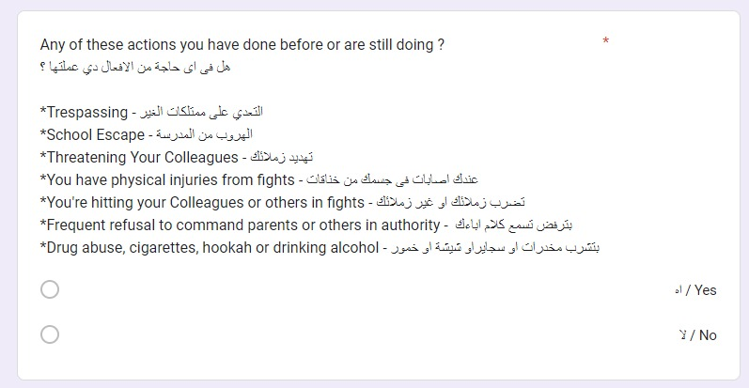
Sample 1 From Created Questionnaire
19

Slide 20
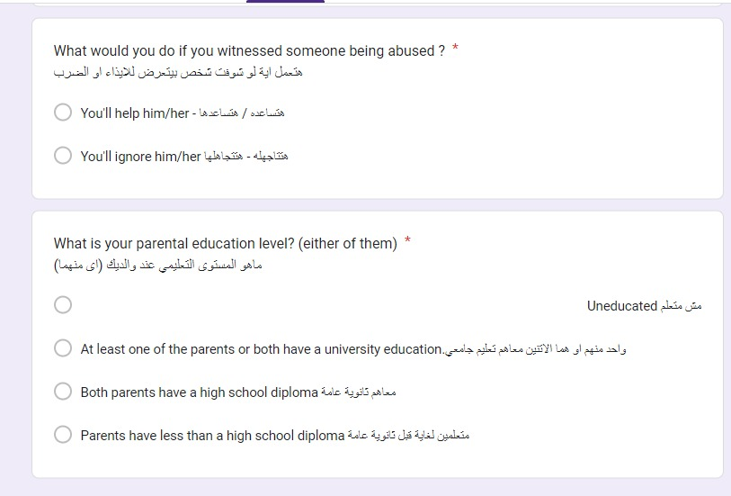
Sample 2 From Created Questionnaire
20

Slide 21
Dataset
Data Collection
To gather the dataset, we created a questionnaire and distributed it through multiple channels, including social media platforms and primary and preparatory schools. We received a total of 1400 responses from students. The main objective is to collect data from the students to build the model. An online survey was created using a Google Form, and 1,400 people responded. Below are some of the survey questions and answers.
21

Slide 22
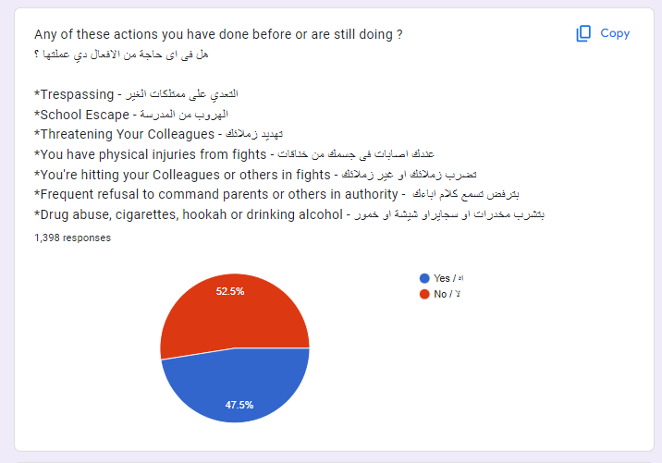
Sample 1: Students responded
22

Slide 23
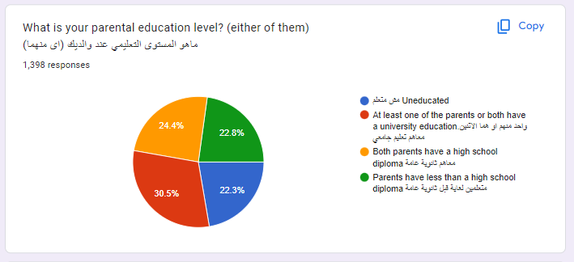
Sample 2: Students responded
23

Slide 24
Results
After splitting the dataset into 70% for training and 30% for testing, Table (1) presents the accuracy results for logistic regression, random forest, and support vector machine.
Algorithm Accuracy
1 | Logistic Regression | 97%
2 | Random Forest | 92.5%
3 | Support Vector Machine | 96.6%
24

Slide 25
Results(cont.)
After splitting the dataset into 50% for training and 50% for testing, Table (2) presents the accuracy results for logistic regression, random forest, and support vector machine.
Algorithm Accuracy
1 | Logistic Regression | 97.5%
2 | Random Forest | 93.7%
3 | Support Vector Machine | 95.5%
25

Slide 26

08
DEMO
26

Slide 28

09
CONCLUSION
28

Slide 29
CONCLUSION
In this work, an effective web-based application is developed using machine learning techniques to identify children at risk of exhibiting violent behavior. An online comprehensive questionnaire was created and submitted to students to be used in assessing risk factors associated with potential violence. Results reveal that Logistic Regression achieved the highest accuracy of 97.5% for automated risk assessment. The reason for having logistic regression with the highest accuracy because the relationship between the features and the outcome is linear.
The current system has a few drawbacks that could potentially have fixes in the future:
1) Detecting the risks of violence among young people, not only for children.
2) Detecting the risks of violence against oneself.
3) To improve the interaction and engagement with the child, the system could consider using indirect questions that are more child-friendly. Instead of directly asking about risks of violence, the system can frame questions in a more subtle and playful manner.
29

Slide 30
Resources
Fast Fact: Preventing School Violence |Violence Prevention|Injury Center|CDC. (n.d.).https://www.cdc.gov/violenceprevention/youthviolence/schoolviolence/fastfact.html
Press Release - New NCES Data Show Increases in School Shootings and Cyberbullying in K–12 Schools Over the Last Decade - June 28, 2022. (n.d.). https://nces.ed.gov/whatsnew/press_releases/06_28_2022.asp.
McCoy DC, Roy AL, Sirkman GM. Neighborhood crime and school climate as predictors of elementary school academic quality: a cross-lagged panel analysis. Am J Community Psychol. 2019 Sep;52(1–2):128–40.
Burdick-Will J. School violent crime and academic achievement in Chicago. Sociol Educ. 2020 Oct;86(4):343–61. https://doi.org/10.1177/0038040713494225.
Mroczkowski, M. M., Walkup, J. T., & Appelbaum, P. S. (2021). Assessing Violence Risk in Adolescents in the Pediatric Emergency Department: Systematic Review and Clinical Guidance. Western Journal of Emergency Medicine, 22(3). https://doi.org/10.5811/westjem.2021.1.49233
Henry, Stuart. "What is school violence? An integrated definition." The annals of the American academy of political and social science 567.1 (2000): 16-29.
Garaigordobil, Maite, and Vanesa Martínez-Valderrey. "Impact of Cyberprogram 2.0 on different types of school violence and aggressiveness." Frontiers in psychology 7 (2016): 428.
Chen, Ji-Kang, and Hsi-Sheng Wei. "The impact of school violence on self-esteem and depression among Taiwanese junior high school students." Social indicators research 100 (2011): 479-498.‏
Van Le, D., Montgomery, J., Kirkby, K. C., & Scanlan, J. (2018). Risk prediction using natural language processing of electronic mental health records in an inpatient forensic psychiatry setting. Journal of biomedical informatics, 86, 49-58.‏
Ni, Y., Barzman, D., Bachtel, A., Griffey, M., Osborn, A., & Sorter, M. (2020). Finding warning markers: leveraging natural language processing and machine learning technologies to detect risk of school violence. International journal of medical informatics, 139, 104137.‏
Barzman, D., Ni, Y., Griffey, M., Bachtel, A., Lin, K., Jackson, H., ... & DelBello, M. (2018). Automated risk assessment for school violence: A pilot study. Psychiatric quarterly, 89(4), 817-828.
30

Slide 31
Thanks
31

